Slide 1
Prepare to Care: Creating an Aging Roadmap
April Ibarra, MGS
Each Home Instead Senior Care® franchise office is independently owned and operated.
Notes:
-Research: 80 million Americans are reportedly conversation avoiders,
-haven’t talked about any important end-of-life issues with their parents or children, or have talked about just one issue.
-70% of family conversation about aging are prompted by an event such as a health crisis or other emergency.
-conversations are highly personal and often emotional
-they can help ensure that the older adult ages in way that best aligns with your wishes.

Slide 2
Objectives During the webinar you will learn how to:
Review aging process and what to expect as an older adult progress from independence to needing more support.
Explore tools to help aging adults develop a plan to help them prepare for their long-term care needs as they age.
Learn how to help families guide the conversation on sensitive subjects such as health, finances, and end of life
Identify trends in products and services to support the increasing needs of older adults as they age in place.
Notes:
Caring for an aging parent or relative is hard enough, but when there is conflict between adult siblings – or sometimes a total communication breakdown – it is an extremely stressful situation for all. I know that many family caregivers often disagree with their siblings about how to care for their parents, and how to divide the caregiving tasks in the fairest way possible.
Please note that this presentation was originally developed for family caregivers…although as professionals I’m sure you are familiar with situations where there is a great deal of conflict between adult siblings as they try to provide the best possible care for their mom or dad. This creates a number of challenges but here are ways to make it easier for both the caregiver and the care recipient. So in this presentation I’ll focus on how you can you can support the clients and families that you work with, by providing information and resources to better manage the family issues that arise related to caregiving.
[Optional: Share a story that highlights a typical scenario – one sibling is primary caregiver, others live far away. Conflicts arise over care decisions for their mom, e.g. moving into an assisted living facility.]
There are a number of ways to minimize family conflicts and overcome disagreements among siblings so the focus can be on caring for the aging loved one.
So during today’s webinar, you will …[ read bullet points on slide]
I know that many of you have been in the field for many years, working with seniors and their families, and while some of this information may be very familiar, this is a great opportunity today to get a refresher on ways to address challenging family dynamics.

Slide 3
Failure to Plan
Only half of older adults have planned or thought about developing a care plan for themselves
73% of adult children have neither planned nor thought about care
Even though becoming a burden can be a major concern, 45% of Americans and 28% of those over 65 have yet to begin discussing their end-of-life care preferences with anyone at all, including their family
Sources: Seniors and the Information Gap (2010)
Source: The Four Pillars of the New Retirement (2020)
Notes:
In an ideal world, everyone would have a plan for how they want to age. But the reality is…about 73% of adult children have neither planned nor thought about care for their aging loved one
And only half of older adults have planned or thought about developing a care plan for themselves
Families need to be encouraged to plan ahead as much as possible.
Transition: when families get together for these types of conversations, I wanted to share some tips for communication…

Slide 4
The Aging Process
Natural Aging
Progresses at different rates in different people
Begins gradually
Changes accumulate
Increasingly affects all systems of the body
80% of older adults have at least one chronic disease and 60% have two or more
Can be treated but the disease will never completely go away
Can increase difficulties caused by natural aging
Notes:
-As a person gets older, two types of changes occur: those that are a result of aging itself (“natural aging”) and those that stem from diseases or chronic conditions.
-Aging is a natural process that progresses differently for everyone.
The rate of aging and the areas of the body affected also vary from person to person.
-Signs of aging may begin gradually and have little effect on how a person lives;
-changes accumulate and eventually affect all systems in the body.

Slide 5
Determining When CHANGE IS NEEDED
From Independence to Support in the Home
Mental
Forgetfulness that impacts daily life
Scorched pots and pans
Losing track of medications
Missed doctors’ appointments and social engagements
Mail and bills that are piling up
Emotional and social
Reluctance to leave the house
Withdrawing from social interactions
Possible signs of depression
Physical and medical
Losing interest in meals
Declining driving skills
Declining personal hygiene
Unkempt house
Notes:
So often caregivers try too shoulder all of the care themselves and when they finally do reach out for help, they are often desperate or “at the end of their rope.” As professionals we can help family caregivers look for signs to help them determine when it is appropriate to bring help into the home. I grouped them into 3 categories: mental, emotional/social and physical/medical
Independence to Support in the Home
Mental
Forgetfulness that impacts daily life
Scorched pots and pans
Losing track of medications
Missed doctors’ appointments and social engagements
Mail and bills that are piling up
Emotional and social
Reluctance to leave the house
Withdrawing from social interactions
Possible signs of depression
Physical and medical
Losing interest in meals
Declining driving skills
Declining personal hygiene
Unkempt house
Transitions: I also often get asked about when it is the right time to move them from the home to a care facility…

Slide 6
Determining When CHANGE IS NEEDED
Home to Facility
Refusal to accept professional help at home
Care needs are beyond level of care available in the home
For those with dementia or Alzheimer's, if behavioral symptoms are too much to manage at home
Cost for 24-hour care is outside of financial ability
Family unavailable
Notes:
This can be a tough decision to make. Often times adult children promise their parent that they will never move them to a nursing home. However, sometimes it is not feasible to follow through on that promise. There are some general indicators that can help families determine if it’s time to move from Home to Facility
Refusal to accept professional help at home – if they have tried it but do not allow for professionals to come to the home, the only other option may be to make a move
Care needs are beyond level of care available in the home - if the individual needs care that cannot be provided at home. It could be due to a medical condition or the layout of the home is not conducive for living safely or cannot be modified.
For those with dementia or Alzheimer's, if behavioral symptoms are too much to manage at home – sometimes symptoms of Alzheimer’s can put the individual or the caregiver in danger. If this is the case, a move to a care facility may be in everyone’s best interest.
Cost for 24 hour care is outside of financial ability – having around the clock care in the home can be expensive and a care facility may be more economical.
I want to be sure to note that every situation is different and it really depends on the situation but these can be helpful guidelines.
Transition: finally, I want to address the well-being of the caregiver…

Slide 7
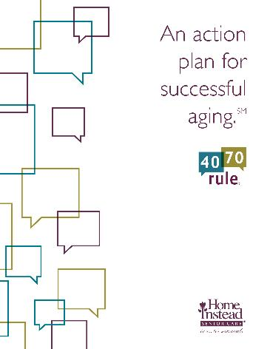
Start the Conversation
Starting conversations early is important, but it’s never too late to get going
The 40-70 Rule®: An Action Plan for Successful AgingSM can help you begin uncomfortable but necessary conversations about aging and put your plans and wishes into action.
Notes:
Because it can be so overwhelming…we created an action plan for successful aging.
I will have a link to this action plan sent to all of you via email but will walk you through the key topics to get your wheels turning.

Slide 8
Identify Expectations about Aging
At your age, and given your gender, how long are you likely to live?
Who do you look forward to about getting older?
As you get older, how can you best take advantage of the experience and wisdom you have accumulated during your life span?
Are there ways you maximize your cognitive functions as you age?
Is your current living arrangement the best choice for your as you age?
Do you know the legal and financial steps needed to retire?
Will you outlive your financial resources?
Does your family know what you want if you were to have a serious health problem and could not speak for yourself?
What services would be available if you became sick or frail?
Who will pay for long term care should you need it?
Life Plan for the Life Span (American Psychological Association, 2018)

Slide 9
The Aging Plan
A personal road map for the older adult to identify their goals for aging and inform others about what’s important, and why
Creates realistic expectation about their goals based on mental and physical health, living arrangements, finances and access to care
The aging plan should be completed by the older adult to understand:
How they want to age
Physical and psychological health now and in the future
Legal and financial maters
Social/personal relationships
End of life care
Legacy

Slide 10
ACT Help Determine what the Future will Look Like
Assess
Consider
Talk
Notes:
This can be a sensitive topic to broach but there are a few important things to keep in mind….
First is empathy. Families should try to put themselves in the shoes of their loved one. Think about the conversation from their perspective. Perhaps the older adult feels that the conversation is a threat to their independence, or perhaps they are embarrassed to admit they need help.
Next, it is important to listen. Involve the older adult in the conversation and really seek to understand the older adult’s wants and wishes. This is so important as we all want to be heard and understood.
You also want to be sure the conversation is inclusive of all. Take a team approach and involve the older adult in the decision making. Remember it is their life and the decisions made impact them directly.
Finally, try to keep the conversation positive and use proactive language. Emphasize the desire to enhance independence and safety. For example: if the person’s desire is to stay home…they family could emphasize that by hiring a professional caregiver to help at home, it can help them stay at home instead of moving.
There is an acronym that can help families with effective communciaiton – ACT: Assess, consider, talk.
Assessing – this means understanding the older adult’s current situation-
STORY: I want to share a story of a client that I worked with who implemented this type of communication with her daughter. Her name is Jodeen and when I first met with her and her daughter, Jodeen’s needs were fairly limited to transportation and light housekeeping. But they talked about how they wanted to plan for the future and what that may look like for Jodeen. So in our discussion, we considered the options…
The next step is “Consider” and this step consists of looking at options as well as the cost of the options. STORY: going back to Jodeen, she expressed that she wanted to stay in her home for as long as possible. She wanted to do so with home care. She also informed me that she had a long-term care policy that she wanted to use. With that information…I helped Jodeen and her daughter look into her long-term care benefits to see what types of services it would cover. Each time I met with Jodeen and her daughter, we continued to“Talk” more about her wishes. Talk is the final part of the acronym.
Talking through the options in so important because it helps both the senior and the family member to get on the same page. The first two steps assessing and considering can be done separately or together. There are pros and cons to both approaches. But the 3rd step most important..

Slide 11
Cost of Care
The reality is 70% of Americans who reach age 65 will be unable to care for themselves without assistance at some point
From 2004 to 2019, the cost for facility and in-home care services has risen on average from 1.71% -3.64% per year. That’s an increase of $892 annually for home care and up to $2,468 for private room in nursing home.
Sources: Daschle, T., & Thompson, T. (2013); Home Care Association of American and Global Coalition on Aging. (2016).
Sources: Genworth Cost of Care Study, 2020
Notes:
When you add up the total amount spend on long term care in the U.S., it is estimated to be $450 billion a year.
The reality is 70% of Americans who reach age 65 will be unable to care for themselves without assistance at some point. And with the growing aging population, that $450B is only going to grow
Transition: next I will review some national averages for the cost of various types of care…
Source website: https://www.washingtonpost.com/opinions/who-will-care-for-americas-aging-population/2013/11/21/2609df64-4657-11e3-a196-3544a03c2351_story.html?utm_term=.5368bd89ff61

Slide 12
Family Care
Fewer family caregivers
Growing distance between family members
Considerations:
Who all is available to care?
How much time do they have to provide care?
Are they close enough to provide consistent care?
Do they have the financial resources?
Will they feel comfortable providing all types of care?
Sources: Caring for America’s Seniors: Value of Home Care Report
Notes:
When an older adult needs assistance, family members are typically the first to step in and help. However, there are fewer family caregivers available to help. For every 1 older adult today, there are on average 7 family members available to support, however, that number will shrinking to 4:1 by 2030 and 3:1 by 2050
There is also a growing Distance between family members with one or more adult children live on average more than 280 miles from their aging parent.3
When families are considering to assist their aging loved one… here are some important things to consider….
Who all is available to care? - Local and long-distance caregivers that can contribute in ways that do not require hands on support. Like ordering supplies online.
How much time do they have to provide care?
Are they close enough to provide consistent care?
Do they have the financial resources? - Some may not have financial resources but have time and some may not have time but have financial resources.
Will they feel comfortable providing all types of care? – for example: hands on bathing assistance may not be something family is comfortable with. That may be one area of support that a family hires professional in home care to help with.
Transitions: next is senior centers and adult care centers…

Slide 13
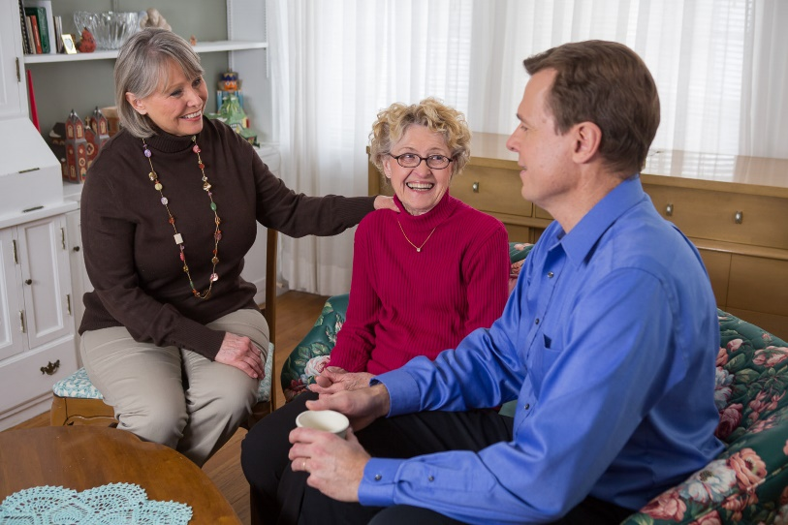
Family Meeting Checklist
Involve your aging love one
Identify and list your loved one’s needs
Prioritize needs
Research options
Divide workload
Plan ahead as much as possible

Slide 14
Family dynamics
Often one sibling takes on majority of care
Top five hot button issues:
Illness
Finances
Inheritance
Distance
Stress
for resources visit:
SolvingFamilyConflict.com

Slide 15
Seven Tips to Help Communicate with Aging Parents
Get started
Talk it out
Sooner is best
Forget baby talk
Maximize independence
Be aware of the whole situation
Ask for help
Notes:
Neither Seniors Nor Adult Children Know:
They assume Social Security, Medicare or parent’s retirement accounts will pay for care
But the reality is . . .
Neither Social Security nor Medicare pays; and,
The true cost of care is unknown or underestimated
People are living longer so personal savings are often inadequate
Planning is triggered by a crisis situation

Slide 16
Trends that Support Aging in Place
Virtual health
CMS changes rules around telehealth in response to the pandemic
Tech enabled care organizations set up in-bound and outreach contacts
Voice tech in the smarter home is the future now
27% of the 65+ population still lack access to broadband
62% of 70+ own a smart phone and 40% own a table the help is still needed to manage devices
Hospital at Home gains traction
Retailers are becoming part of the health care delivery system
Sources: The Future of Remote Care Technology and Older Adults (2020)

Slide 18
Questions?
Each Home Instead Senior Care® franchise office is independently owned and operated.
Notes:
Thank you so much for joining the webinar today.

Slide 19
Resources
The Aging Plan – 4070talk.com
Step by step guide to planning your aging journey
Conversation starters
MakingHomeSaferforSeniors.com
Home safety checklist
Inexpensive fixes for safety & convenience
Caregiverstress.com
Genworth Cost of Care Survey
www.genworth.com/cost-of-care
AgingWithDignity.org
SeniorEmergencyKit.com
SimpleMeds.com
Notes:
www.Caregiverstress.com has a video on financial management issues that you may find an excellent resource.
AARP-Health care cost calculator

Slide 20
April Ibara, MGS
Home Instead Senior Care
Gerontologist & Strategic Partnerships Manager
email
April.Ibarra@homeinsteadinc.com

